Slide 1

Chapter 10: Finite State Machines

Slide 2
Introduction
Finite state machines are used for modeling the control and sequencing view of a system or object.
Many systems, such as real-time systems, are highly state-dependent: their actions depend not only on their inputs but also on what has previously happened in the system
UML: State transition diagram is referred to as a state machine diagram
This course: Statechart and state machine diagram are used interchangeably

Slide 3
Contents
1. Finite state machines and state transitions
2. Action
3. Entry Actions
4. Exit Actions
5. Hierarchical statecharts
6. Guidelines for developing statecharts
7. Developing statecharts from use cases
8. Example

Slide 4
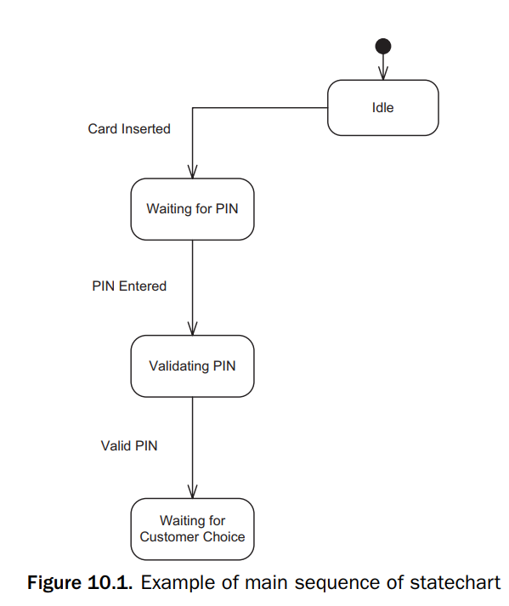
1. Finite state machines and state transitions
A finite state machine is a conceptual machine with a finite number of states
The next state depends on the current state, as well as on the input event

Slide 5
1. Finite state machines and state transitions
A state represents a recognizable situation that exists over an interval of time
A state transition is a change in state that is caused by an input event
An event is an occurrence at a point in time. An event is an atomic occurrence (not interruptible) and conceptually has zero duration. Events can depend on each other.
The first event (Card Inserted) causes a transition into the state (Waiting for PIN)

Slide 6
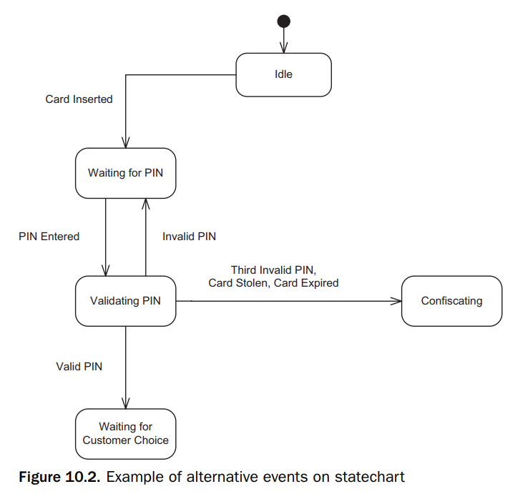
Example
Previuos Figure 10.1. Example of main sequence of statechart
It is possible to have more than one transition out of a state, with each transition caused by a different event :
Three possible state transitions out of the Validating PIN state

Slide 7
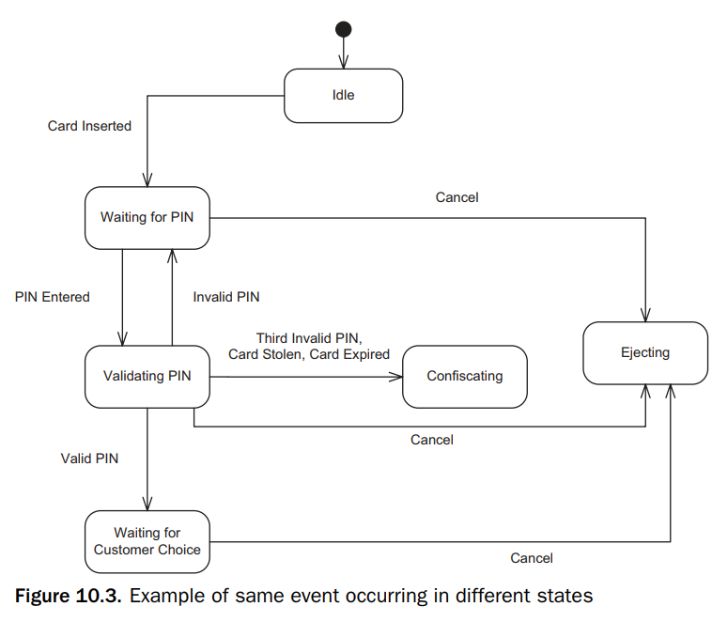
Example
it is also possible for the same event to occur in different states and have the same effect;
The customer may decide to enter Cancel in any of the three states Waiting for PIN, Validating PIN, or Waiting for Customer Choice
=>
Same event: Cancel
Same effect: Ejecting

Slide 8
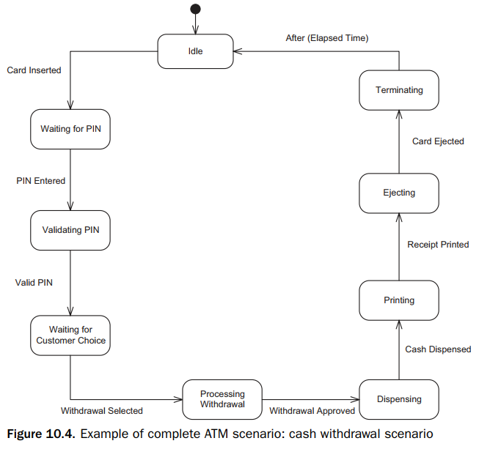
Example
It is also possible for the same event to occur in a different state and have a different effect
For example, if the PIN Entered event arrives in Idle state, it is ignored

Slide 9
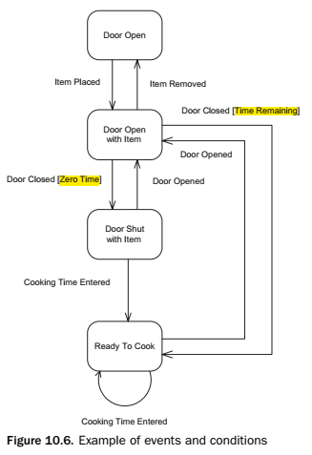
Events and Guard Conditions
It is possible to make a state transition conditional through the use of a guard condition. This can be achieved by combining events and guard conditions in defining a state transition.
The notation used is Event [Condition]

Slide 10
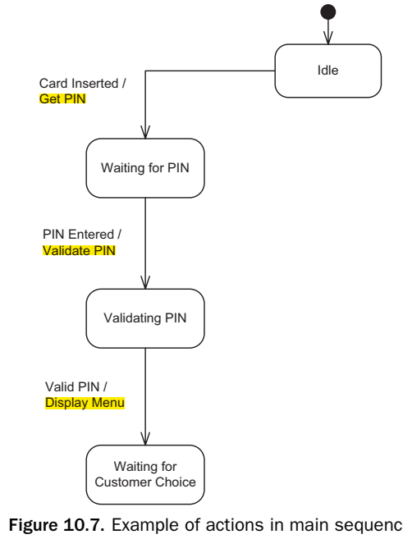
2. Action
Associated with a state transition is an optional output action
An action is a computation that executes as a result of a state transition. It can be associated with a state transition and depicted on state transitions.
A transition action is an action that is a result of a transition from one state to another (itself).
To depict a transition action on a state chart, the state transition is labeled:
Event/Action
Event [Condition]/Action.

Slide 11
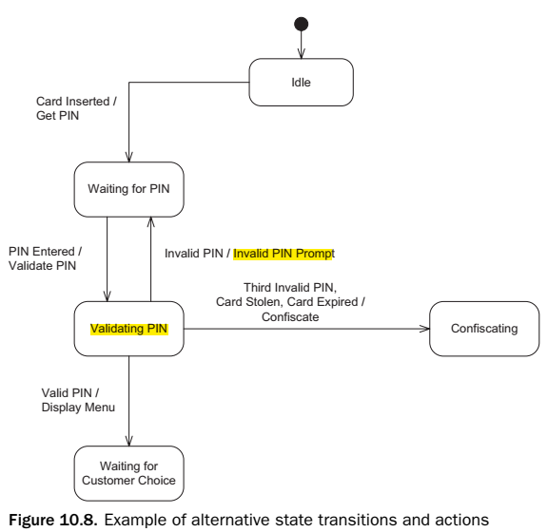
2.Action
More than one action can be associated with a transition. Because the actions all execute simultaneously, there must not be any interdependencies between the actions.
Because there is a sequential dependency between the two actions, the change cannot be displayed before it has been computed. To avoid this problem, introduce an intermediate state.
Alternative actions

Slide 12
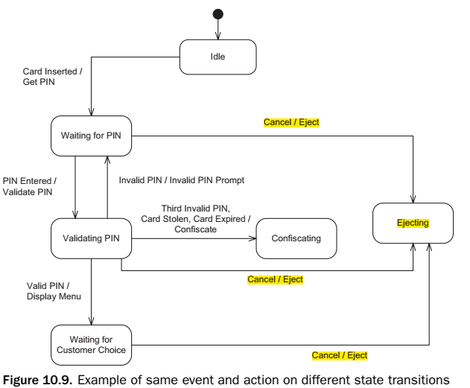
2. Action
The same event can cause transitions out of several states, with the same action in each case.

Slide 13
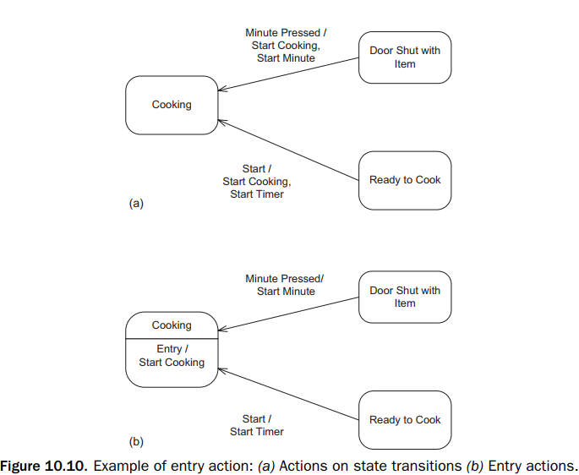
3. Entry Actions
An entry action is an instantaneous action that is performed on transition into the state.
The best time to use an entry action is when the following occur:
There is more than one transition into a state.
The same action needs to be performed on every transition into this state.
The action is performed on entry into this state and not on exit from the previous state
Entry Action executed on entry into state with the notation: Entry / action inside the state box

Slide 14
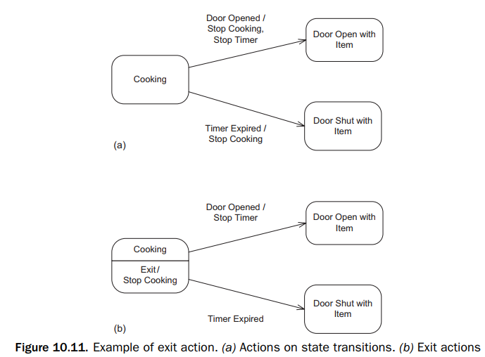
4. Exit Actions
An exit action is an instantaneous action that is performed on the transition out of the state The best time to use an exit action is when the following occurs:
There is more than one transition out of a state.
The same action needs to be performed on every transition out of the state.
The action is performed on exit from this state and not on entry into the next state.
Exit Action executed on exit from state with the notation: Exit / action

Slide 15
End of part 1

